Slide 1
Disease Prediction A network theory + ML approach
Andrea Alberti
Davide Ligari
Cristian Andreoli
Matteo Scardovi
University of Pavia
Financial Data Science
course
Notes:
Today, we present our project on disease prediction, a collaborative effort by myself, Davide Ligari, and my esteemed colleagues Andrea Alberti, Matteo Scardovi, and Cristian Andreoli.

Slide 2

Dataset
Kaggle dataset
773 unique diseases
377 unique symptoms
246.945 samples
Artificially generated
Notes:
The dataset is taken from Kaggle, It is Artificially created but preserving Symptom Severity and Disease Occurrence Possibility. It contains 773 diseases and 377 symptoms.

Slide 3
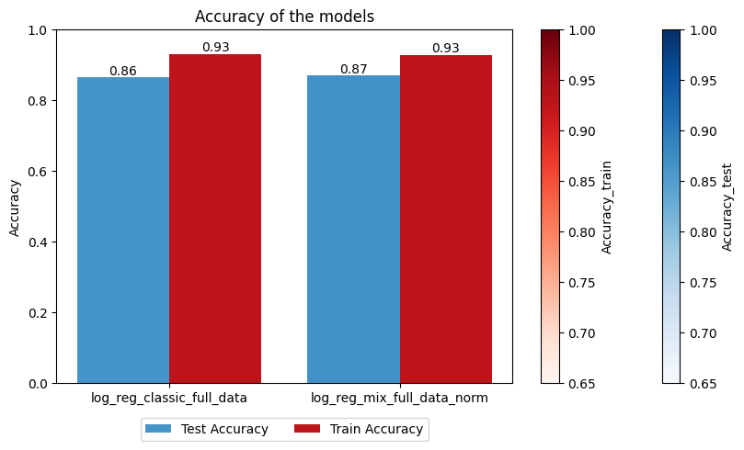
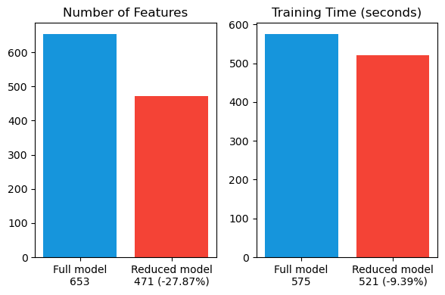
Our Objectives
GOAL 1
Evaluate the effectiveness on diseases prediction models of new features extracted from a bipartite graph (symptoms – diseases)
GOAL 2
Evaluate the effectiveness of graph-based solutions in improving the prediction models computational efficiency
Notes:
We mainly have to objective: the first is to enrich the dataset with information about the network, in order to improve the model performance and generalization. The second is to extract from the network the most relevant symptoms and remove from the dataset the less important ones, in order to reduce the computational cost of the training phase and possible overfitting.

Slide 4

Summary
Network
Model ML
Results
Network Creation
Method of Reflections
Data Preparation
Features Extraction
Best Model Selection
New Features Effect ( GOAL 1 )
Betweenness Centrality
Communities Detection
Candidate Models
Operative Flow
Best Model Analysis
Time Reduction ( GOAL 2 )
Notes:
Here are shown the main steps that we followed to achieve our goals.
In which we firstly created the network and computed the metrics that will be integrated into the dataset .
Then choose the best model and optimal features and finally we analysed the performance of the best models.

Slide 5
Network Methodology and Results
Most Important Actors
Network Creation
Method of Reflections
Betweenness Centrality
Communities Detection
Notes:
Let's now delve into the Network Analysis phase, where we'll explore four key concepts: Network Creation, Method of Reflections, Betweenness Centrality, and Communities Detection. Each of these will guide us in understanding the structure and influence within our network.

Slide 6
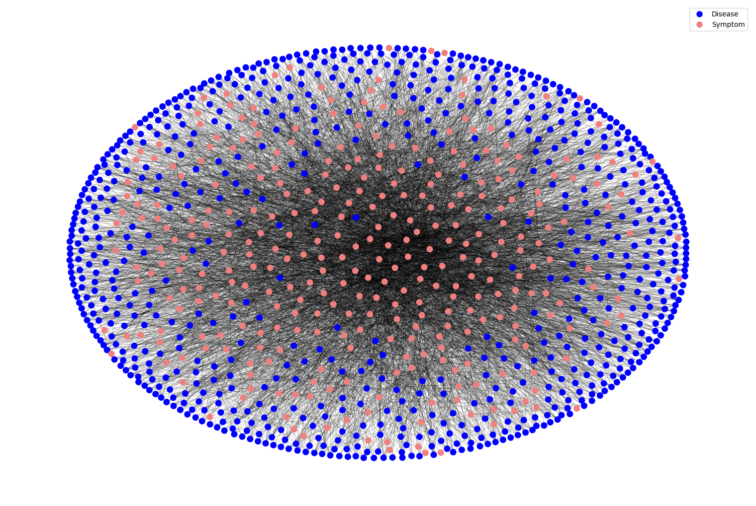
Network Creation
Bipartite network
unweighted
Removed isolated nodes (52 symptoms)
Notes:
Here we see the network. This is a bipartite, unweighted graph where we've removed isolated nodes, specifically 52 symptoms, to streamline our analysis

Slide 7
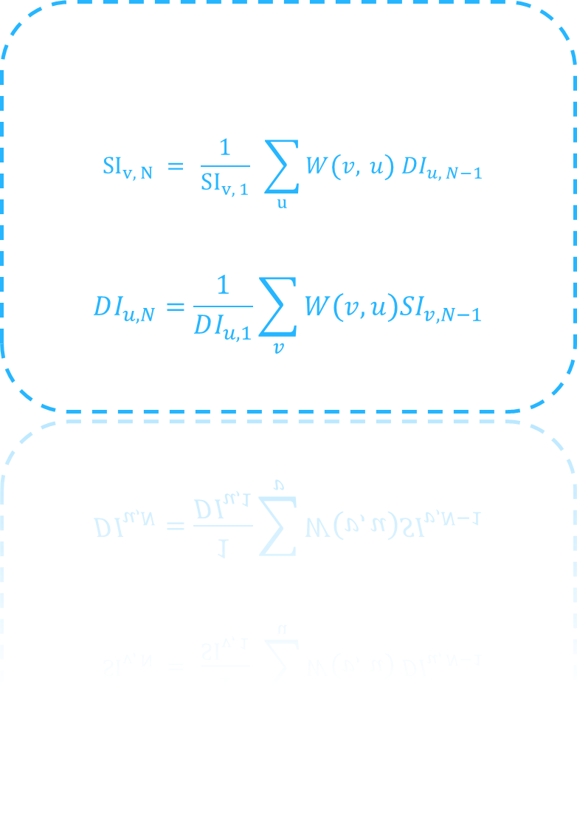
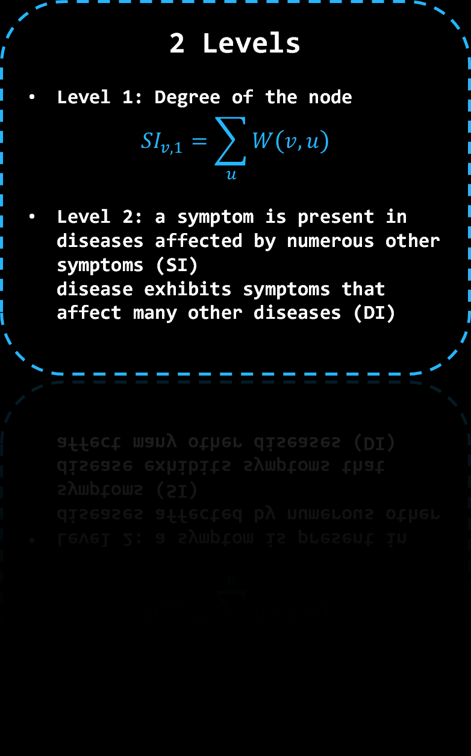
Method of reflection
2 Levels
Level 1: Degree of the node
$$SI_{v,1}=\sum_{u}{W\left(v,u\right)}$$
Level 2: a symptom is present in diseases affected by numerous other symptoms (SI) disease exhibits symptoms that affect many other diseases (DI)
2 Indexes
SI index: related to symptom nodes
$$SI_{v, N} = \frac{1}{SI_{v, 1}} \sum_{u}{W\left(v, u\right) DI_{u, N−1}}$$
DI index: related to disease nodes
$$DI_{u,N}=\frac{1}{DI_{u,1}}\sum_{v}{W\left(v,u\right)SI_{v,N−1}}$$
Notes:
We used the metrics introduced by Hidalgo to identify complex relationships between symptoms and diseases. We create two indexes : SI for symptoms and DI for diseases. And we considered just the first 2 levels : level 1 which is the degree of the node and level 2 which captures more complex relationships, in particular, for symptoms it considers whether a symptom is present in diseases affected by numerous other symptoms and for diseases it consider whether disease exhibits symptoms that affect many other diseases (DI).

Slide 8
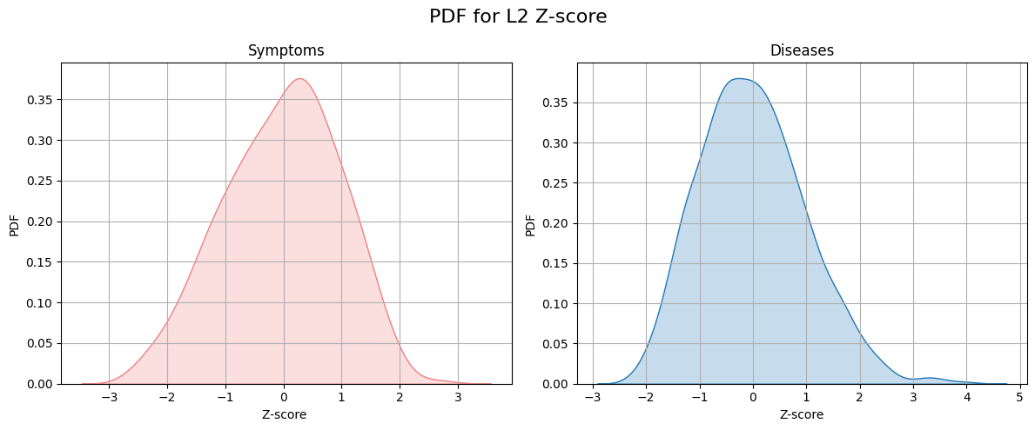
Method of reflection
Significance test
Employed null models
Mean Close to 0 and Variance too high
H0 Rejected
Notes:
To validate the significance of the second level, we compared it against null models through z-score analysis. The results indicate that the second level indeed holds more informative value than the first, with a variance significantly greater than expected under the null hypothesis.

Slide 9
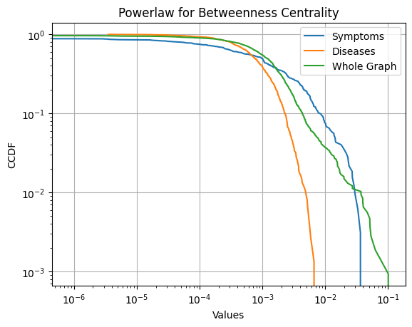
Betweenness Centrality
Power Law Distribution
Scale-free network with few Hubs
Symptoms have higher betweenness than diseases
Symptoms tends to have higher degrees
Bad under predictive standpoint
Notes:
The network showed a power law distribution for the betweenness centrality, indicating a free-scale network with only few hubs that works as connectors for the other nodes. Specifically, we divided the betwenness centrality into the two classes symptoms and diseases and we noticed a higher betweenness value for the symptoms. This finds justification in the higher degree of symptoms. Indeed if a node is connected to many diseases and those have few nodes, the probability of passing through the original node for a shortest path is large. Unfortunetely this is not a good new under a predictive standpoint, since the symptoms are not very specific and each one contribute to many different classes.

Slide 10
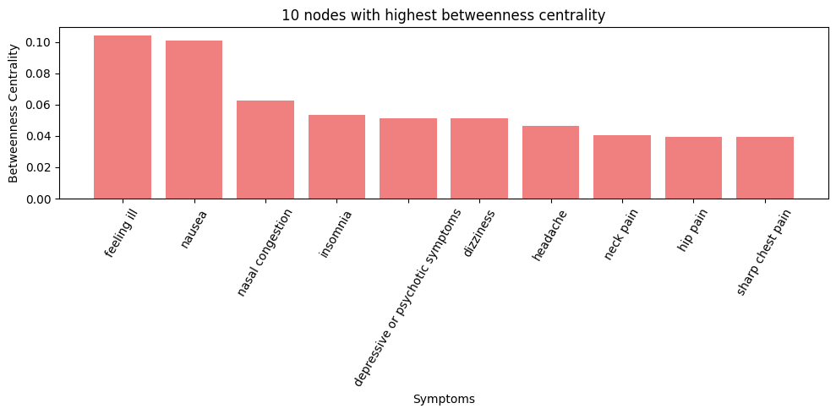
Betweenness Centrality
Most influential nodes
They are all symptoms
Very commonly present
Notes:
Here we analyzed the top 10 nodes for betweenness centrality and we can see they are all symtpoms which are very commonly know and present in many diseases like nausea, headache and the others.

Slide 11
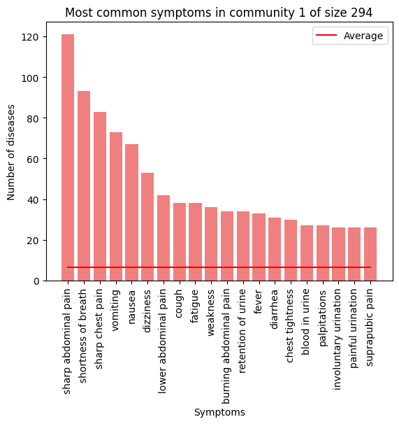
Communities Detection
Co-occurrence similarity
Greedy Modularity Maximization
3 Communities each
INFO 1: symptoms in same communities frequently co-occur within same diseases
INFO 2: symptoms specificity for a given community
INFO 3: diseases specificity for a given community
Notes:
We also investigated the communities in our network. We used the co-occurrence as a similarity measure and the greddy modularity maximization algorithm to compute the communities.
We found 3 communities for each of the two classes and from this classification we can gain 3 types of information. Firstly we can discover which symptoms co-occur more frequentely together, since we use the co-occurrence matrix as a similarity measure. Secondly we can discover the symptom specificity for a given community. To better understand this point we inserted the figure on the right.
In this case we take the community 1 of disease and we investigated which symptoms are more present in the diseases of the community.
Example sharp abdominal pain is present in 120 diseases out of 294, making it a very specific symptom if we consider that on average the symtpoms
Manifest in less than 10 diseases of community 1.
The same study has been conducted also on the symptoms side and all the results can be found in the report.

Slide 12
Communities Detection
Features
Community Size
Replace symptom with size of its community
Each symptom belongs to community of a given size
Model can distinguish symptoms from large or small communities
If many symptoms from small community, the diseases of that community may be more likely
Community Count
How many symptoms are from a given community
Each symptom community has different common diseases.
Model can learn prioritizing diseases from community with highest count
Notes:
From communities we extracted two kind of features. The advantage of count is that since each community has different diseases which are common, if we provide the model with the number of symoptoms for each community, the model can learn prioritizing the diseases of that community.
The advantage of second is similar, in this case the model is feed with information about the community size. The interpretation is more difficult. In general we can say that, If count is high for a community, diseases of that community should be more probable, but if the count of a small community is high, than the associated diseases may be even more probable.

Slide 13
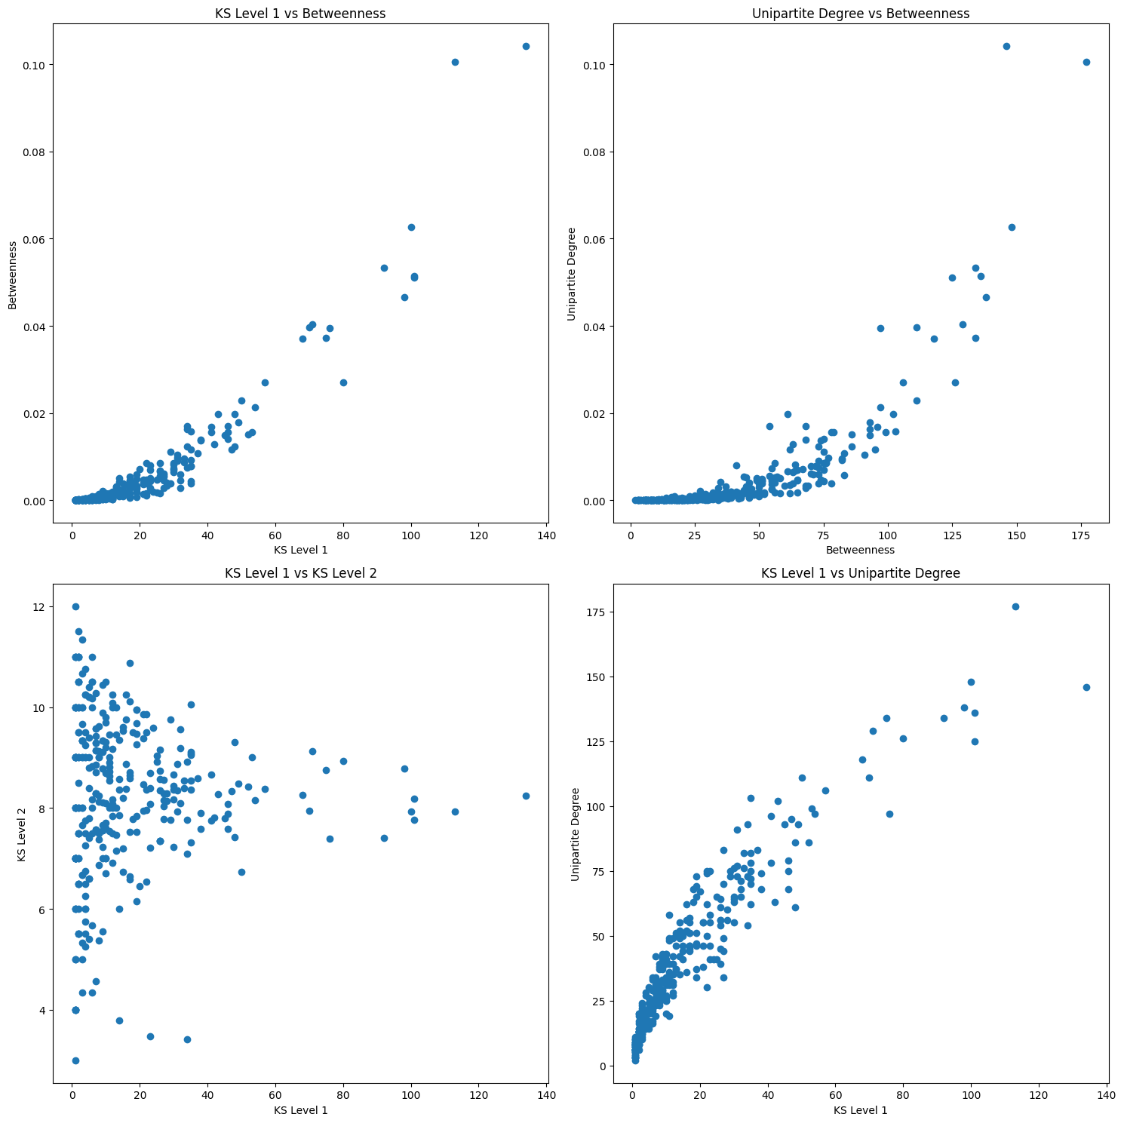
Most Important Actors
Features Reduction
Various combinations options
Take the most uncorrelated
Classification based on thresholds (0.5 * avg deg)
Notes:
Looking toward to the second goal, that of complexity reduction, we decided to perform an analysis on the most important actors of the network. Each metric can deliver different results in term of importance of a node and we decided to consider a combination of metrics able to provide us with a meaningful interpretation of the node importance which we discuss later on.
In the figure we can see the scatterplot of different combinations of metrics and they are all correlated except for L1 and L2. The correlation is very important, indeed if two metrics are highly corelated they are
Providing us with the same information. If instead they have no correlation, adding the second metric we are gaining new information about the data.
We went for L1 and L2 and we decided a node classification threshold based, where the threshold is set as 0,5*avg_deg, resulting in a value of 8.

Slide 14
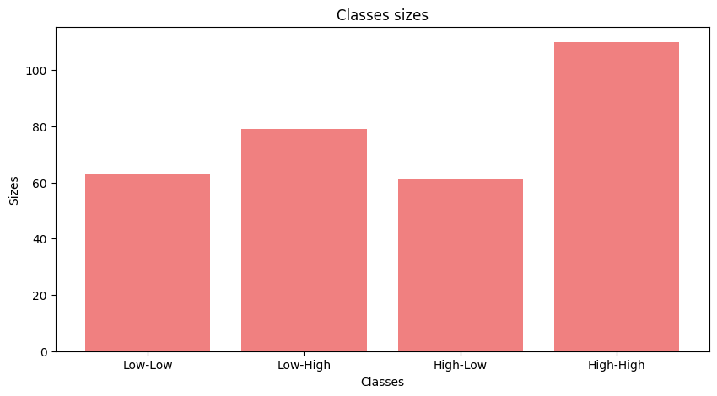
Most Important Symptoms
Provided Insights
Low-Low: very important for prediction of specific diseases
Low-High: less specific than the first class
High-Low: important in general
High-High: important for overall
Same analysis done for diseases to find the most symptomatologically complex
Notes:
As regard the interpretation we can analyze here the most important symptoms which are of our interest for the goal of feature reduction. Explain class meaning.
We perfomed the same analysis for the diseases and in this case we focused on the high high class in which we have the most symptomatologically complex diseases, having many symptoms which are not specific.

Slide 15
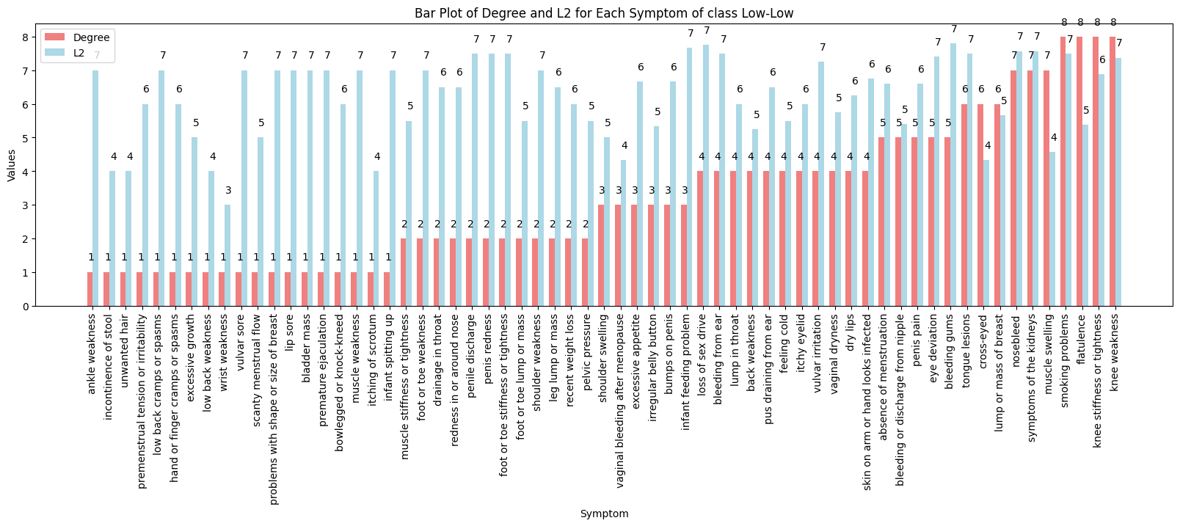
Most Important Symptoms
Notes:
Here is just reported the composition of the most important class for the symptoms.

Slide 16
ML Models
Data Preparation
Features Extraction
Model
Selection
Final
Results
Notes:
Now we analyze the ML models part

Slide 17
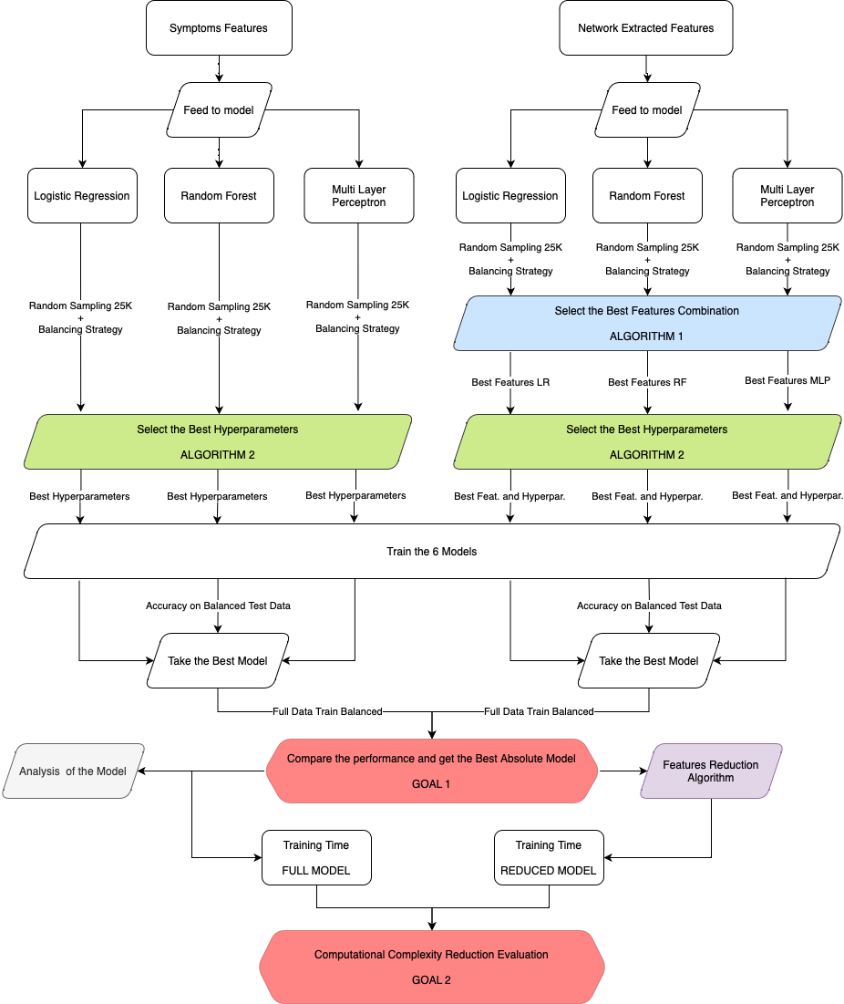
Operative Flow
Core Operations
Sampling + Balancing
Features Combination
Hyperparameters Choice
Model Selection
Features Reduction
Notes:
In order to choose and train the best model, we followed a meticulous ladder.

Slide 18
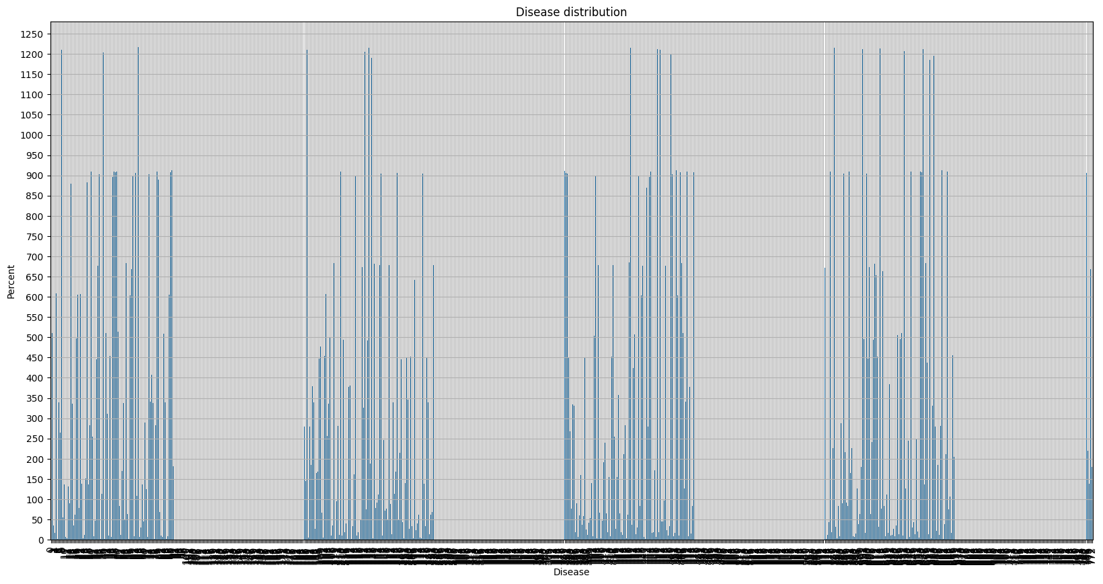
Data Preparation
Random Sampling
Unbalanced Classes
Dataset larger than 250k
Many operations to be performed
Random Sampling of 10% of data
Notes:
We had a really big dataset with over 250,000 (two-hundred and fifty thousand) entries.
To make our work doable and trustworthy, we decided to use only 10% of the data randomly.
This way, it was easier to handle, and our dataset still represented the real situation.
But we faced a common problem in data science, unbalanced classes.

Slide 19
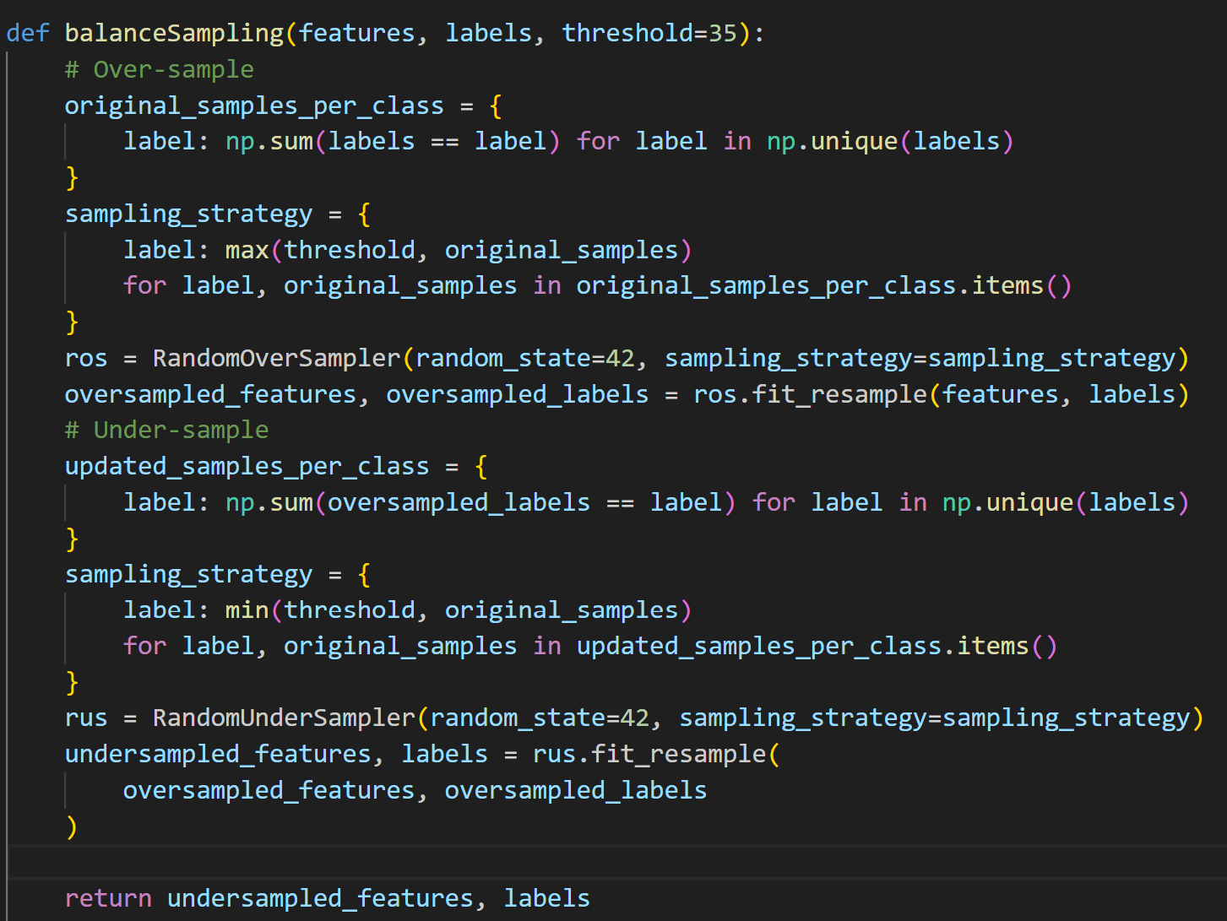
Data Preparation
Oversampling and Undersampling
Balancing Function
Classes with more than 1200 samples
Classes with less than 10 samples
Very high delta
Gain more than 5% accuracy
Notes:
To fix this, we used techniques called oversampling and undersampling.
These methods are designed to equalize the representation of each class,
thereby providing a more level playing field for our algorithms to learn from.

Slide 20
Features Extraction
Classic Features
Symptoms one hot encoding
Network Features
L1 and L2
Betweenness
Comm Count
Comm Size
Notes:
In features extraction We take symptoms and turn them into simple numbers using one-hot encoding.
In addictional, we analyze how these symptoms interact in a network, using measures like Betweenness and Community metrics.

Slide 21
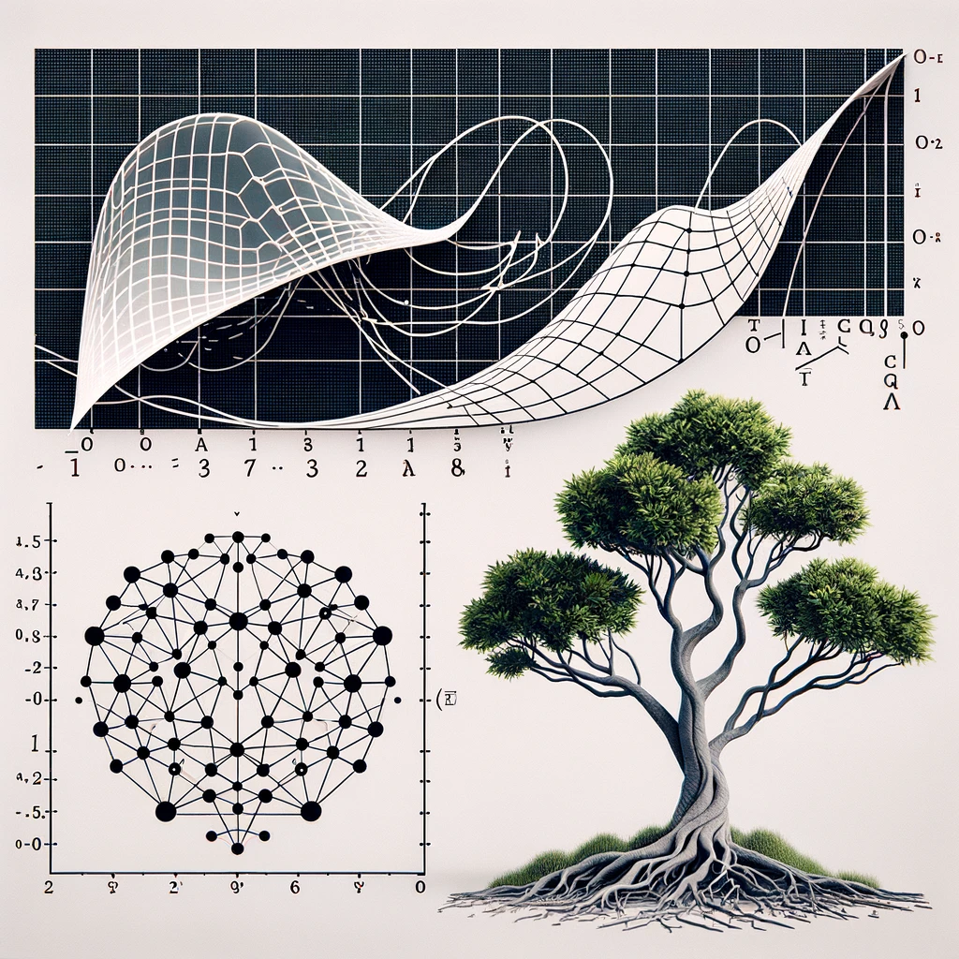
Model Selection - Candidate Models
Model Choice
Random Forest
Logistic Regression
Multi-Layer-Perceptron
Notes:
Our choice for the model narrows down to three models, RF LR and MLP, renowned for their robust predictive capabilities in the field of disease prediction.

Slide 22
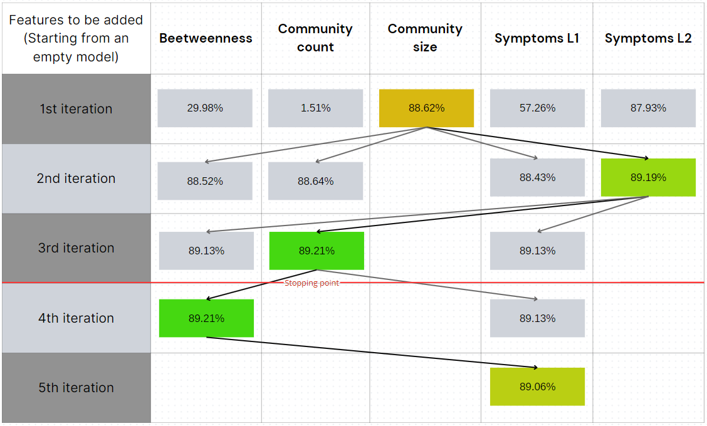
Model Selection – Features Selection
More complex isn't always better
Forward stepwise feature selection
Accuracy maximization
Example: logistic regression
Notes:
In Features Selection step, For each candidate model, we search the best features combination, that was selected through forward stepwise selection.
This process is guided by one goal: maximizing accuracy.
We often reach our best model within just 2 to 3 iterations.

Slide 23
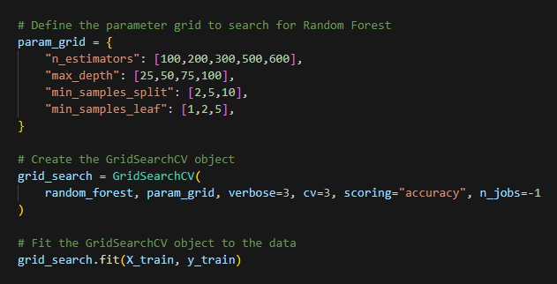
Model Selection - Parameters Tuning
Greedy Approach
Tuning Process
Unfeasible GridSearch approach
Tuning just one parameter at time
No best absolute combination
CrossValidation
Notes:
Now, let's talk about fine-tuning our model.
Instead of trying every possible combination of settings (which would take forever), we took a more practical but Greedy Approach.
Instead of searching for the best combination of all parameters simultaneously,
we tuned one parameter at a time, ensuring that each step moved us towards a more optimal model.
It’s essential to understand that while this method may not yield the absolute best combination,
it provides a balance between thoroughness and computational efficiency.
We also leverage on cross-validation that is essencial to prevent overfitting,
and ensuring that the model is robust across different subsets.

Slide 24
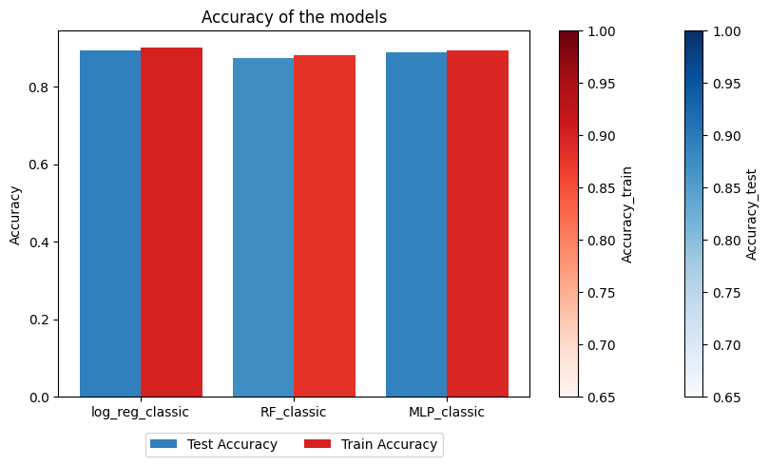
Model Selection – Symptoms only
Trained Models
Logistic Regression
Random Forest
MLP Neural Network
Notes:
After finding the best parameters we trained 6 models
The first 3 only have the symptom feature one-hot vectors. In all 3 cases there is consistently low overfitting, reaching almost 90% accuracy for train and test data with all 3 models.

Slide 25
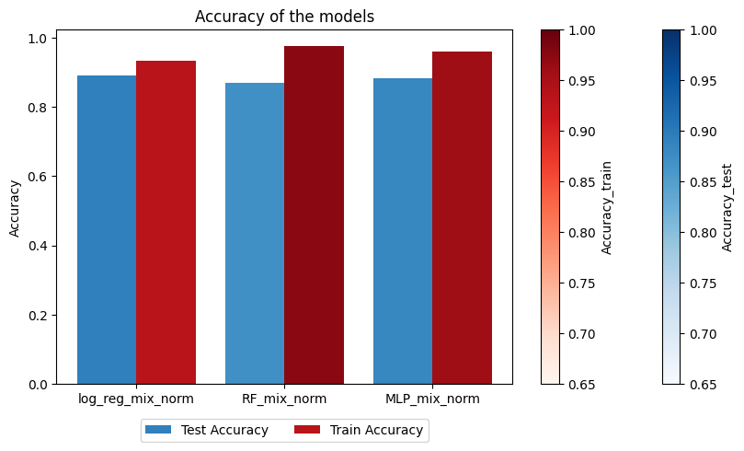
Model Selection – New Features
Trained Models
Logistic Regression
Betweenness, Count, Size
Random Forest
Betweenness, Count, Size
MLP Neural Network
Count, Size
Notes:
Then we trained 3 models using the network features
These models have some overfitting, with 90% test and 95% train accuracy
this can be expected because there are many more features with respect to the symptom-only models
We chose to retain the logistic regression because it has the best performance

Slide 26
Final Results - Network Features Effect
GOAL 1
Equal performance as substitute
More features thus complexity
Simplicity of the dataset
Notes:
We compared the effect of the new features with respect to the symptom only model
It only sligthly improved the model (around 1%), but it made it more complex
One cause is the datatset is artificially generated, so it probably is linearly separable with added noise, so as a future work this analysis can be repeated on more complex data
Completed the first goal: the comparison between the two kind of models
For further analysis we will consider the model based on network features

Slide 27
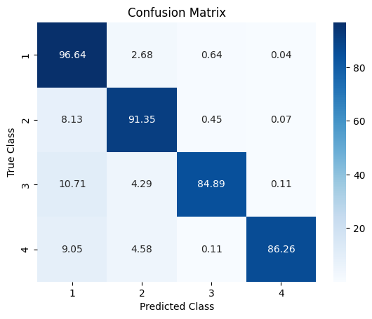
Final Results - Best Model Analysis
Performance Analysis
Classes based on the
Disease Influence indexes
Diseases with low
diagnostic accuracy
Most impactful symptoms
Notes:
-For a classification problem with this many classes the overall accuracy isn't the only metric to rely on. At the same time, it's impossible to evaluate the performance for each single disease class
-We evaluate the accuracy for each clustered class based on DI L1 and L2, using as we defined before the classes low-low, low-high, ettc
-Where there's low diagnostic accuracy: overlap

Slide 28
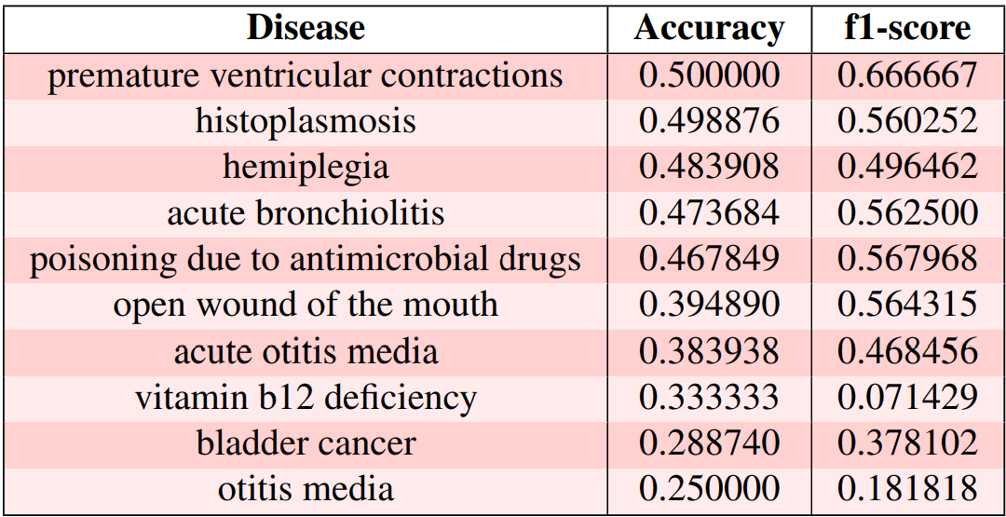
Final Results - Best Model Analysis
Performance Analysis
Symptoms overlap
Notes:
The worst performing diseases are the ones where their symptoms greatly overlap with other diseases
For example bladder cancer shares 90% of it's symptoms with a specific type of diabetes

Slide 29
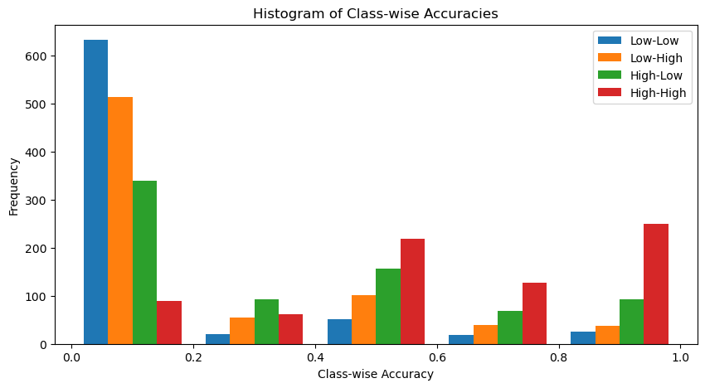
Final Results - Complexity Reduction
Division based on SI indexes
Complexity-Accuracy tradeoff
GOAL 2
Results on the full dataset:
metrics comparison
Time reduction
Notes:
-To isolate the most important features, we divided them into 4 classes based on syptom indexes L1 and L2
Using only the most specific symptoms yields a low accuracy for many classes
-We expanded the feature set including increasingly more features, reaching a good balance of complexity (-30% features) and accuracy (-1% accuracy)
-We then tested on the full (balanced) dataset, including more metrics (precision, recall, accuracy) which as espected only lowered by a percent and a half with respect to the full model. The area under the roc curve was basically the same, so it performed well also across all classes.
-The resulting time reduction was 10%, by lowering the

Slide 30
Conclusion
Achievements:
Network models have a similar performance with respect to symptoms models
A good balance between features reduction and model performance was achieved
Limits:
Feature selection
Hyperparameters tuning
A detailed and complete explanation of all the limits can be consulted in the report
Notes:
We achieved goal 1 of comparing performance
We achieved goal 2 of reducing complexity
The limits are the interdependence between feature selection and hyperparameter tuning

